Slide 1
Term project
CA, 2017 Fall
Sang Jun Nam, TA
heesosic@korea.ac.kr

Slide 2
Overview
Objective: Improvement of cache replacement policy
Given
Cache
Improved cache replacement policy
More improved cache replacement policy
Modify
Modify
Proposed cache replacement policy report
10 pts
Cache hit rate of proposed cache replacement policy
5 pts
Source code analysis report 10 pts
Cache hit rate of proposed cache replacement policy
5 pts
Due : 12/4 23:59:59
Due : 12/11 23:59:59

Slide 3
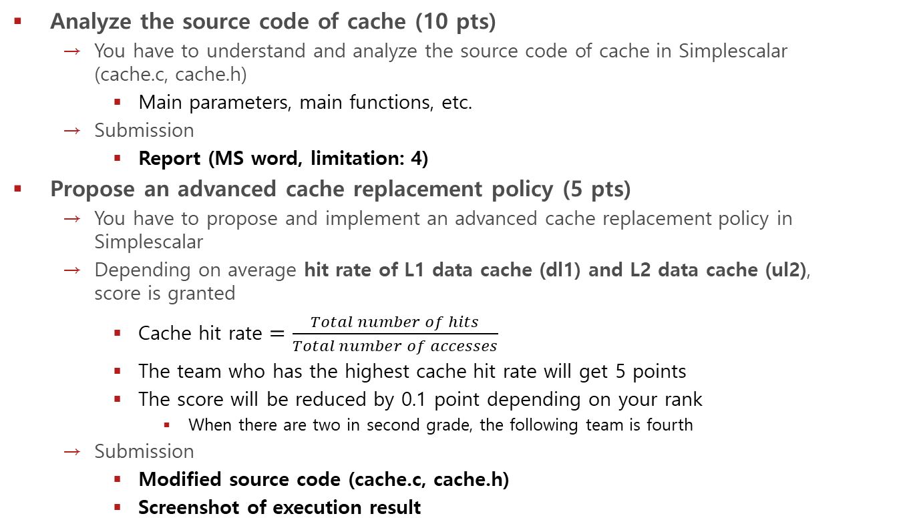
1st term project
Analyze the source code of cache (10 pts)
You have to understand and analyze the source code of cache in Simplescalar (cache.c, cache.h)
Main parameters, main functions, etc.
Submission
Report (MS word, limitation: 4)
Propose an advanced cache replacement policy (5 pts)
You have to propose and implement an advanced cache replacement policy in Simplescalar
Depending on average hit rate of L1 data cache (dl1) and L2 data cache (ul2), score is granted
Cache hit rate $=\frac{Total number of hits}{Total number of accesses}$
The team who has the highest cache hit rate will get 5 points
The score will be reduced by 0.1 point depending on your rank
When there are two in second grade, the following team is fourth
Submission
Modified source code (cache.c, cache.h)
Screenshot of execution result
Due date: 12/4 (Monday) 23:59:59
koreasmrl@gmail.com

Slide 4
2nd term project
Propose a more advanced cache replacement policy (15 pts)
You have to propose and implement a more advanced cache replacement policy in Simplescalar
You have to submit your proposed cache replacement policy report (10 pts)
Which scheme is used
Depending on average hit rate of L1 data cache (dl1) and L2 data cache (ul2), score is granted (5 pts)
Same as 1st
Submission
Modified source code (cache.c, cache.h)
Proposed cache replacement policy report (MS word, limitation: 2)
Screenshot of execution result
Due date: 12/11 (Monday) 23:59:59
koreasmrl@gmail.com

Slide 5
Cache parameters
L1 Data Cache (dl1)
Number of sets in the cache 64
Block size of the cache 32
Associativity of the cache 8
L2 Data Cache (ul2)
Number of sets in the cache 512
Block size of the cache 64
Associativity of the cache 8
Other Cache
Number of sets in the cache: (default)
Block size of the cache: (default)
Associativity of the cache: (default)

Slide 6
Notice
How to measure cache replacement policy
As benchmark, you have to use applications below
apsi
mcf
You have to use Simplescalar source code and configuration, decided by TA
Configuration – default values
Don’t modify Simplescalar source code and configuration except for things related to cache replacement policy
※ Remember!
If you use other benchmarks, or modify configuration except for cache replacement policy, you will get 0 point
Two people per a team
You have to look for your partner
It doesn’t matter, if you do alone (but, providing no benefit)
Send me an e-mail about partner until 11/27 (Monday)
koreasmrl@gmail.com
About late submission
Report
2 points are subtracted within a week from the due date
After a week, 0 point is granted
Others
After the due date, 0 point is granted

Slide 7
Q&A

